Slide 1


Velocity Review
Speed vs. Velocity
  Speed—How fast you move!!
  Velocity—Speed in a particular direction!!
Where:
  d is distance(or displacement)---given in m or km
  t is time----given in s or hr
  v is velocity-----given in m/s or km/hr

Slide 2
Velocity Vector Addition:
Same direction: add them, keep same direction
15 m/s
6 m/s
Opposite Direction: subtract them, keep direction of the larger!!
E
21 m/s
E
E
Up
20 m/s
Up
50 m/s
30 m/s
down

Slide 3
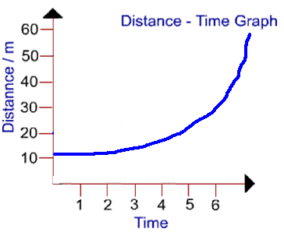
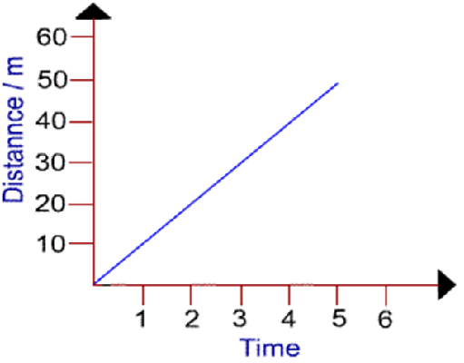
Velocity Review(cont.)
Slope of a distance vs. time graph is equal to the velocity!!!
Always!!!
If slope is straight, velocity is constant!
If slope is not straight, velocity is not constant(it is changing)!!

Slide 4
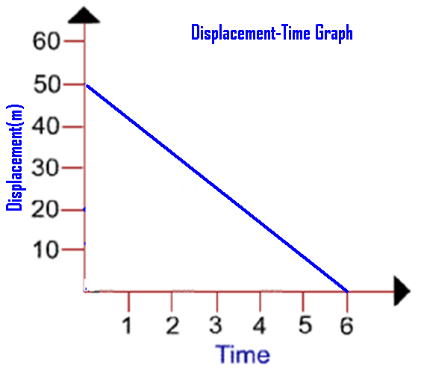
Velocity Review(cont.)

Slide 5
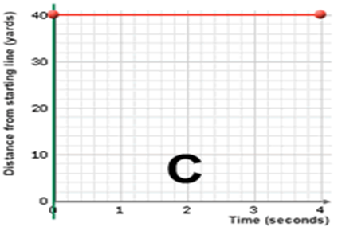
Velocity Review(cont.)

Slide 6
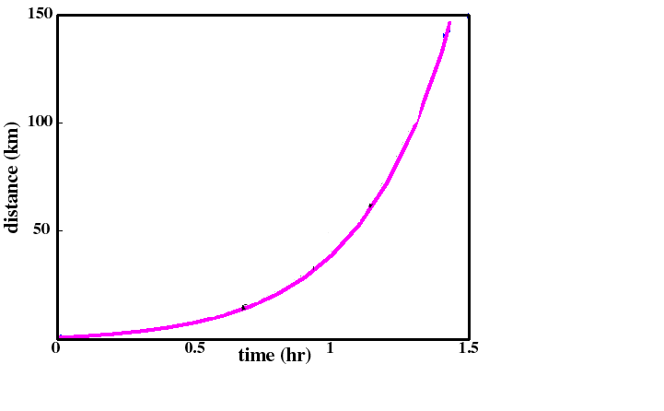
Velocity Review(cont.)

Slide 7
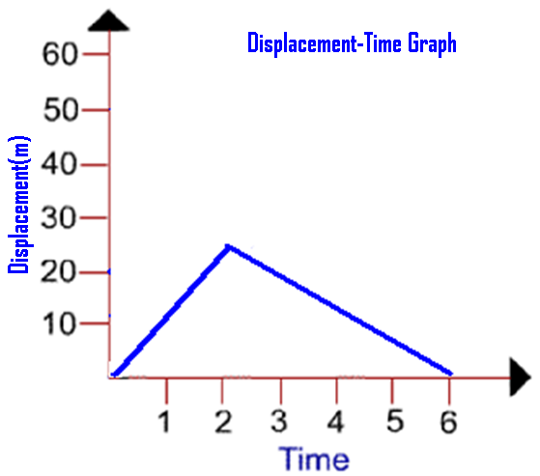
Velocity Review(cont.)

Slide 8
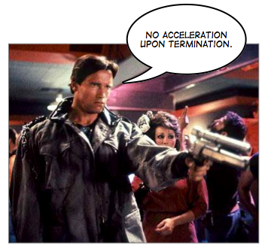





Accelerated Motion

Slide 9
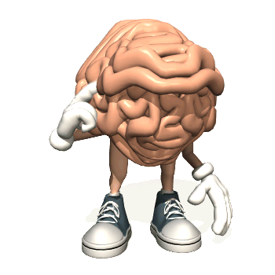
Acceleration
Defined as a rate of change of velocity.
In order to accelerate, an objects’ velocity must change!!
3 ways to change velocity:
  Speed up.
  Slow down.
  Change direction

Slide 10

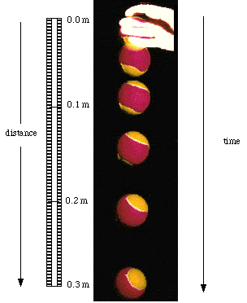

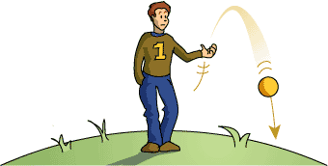

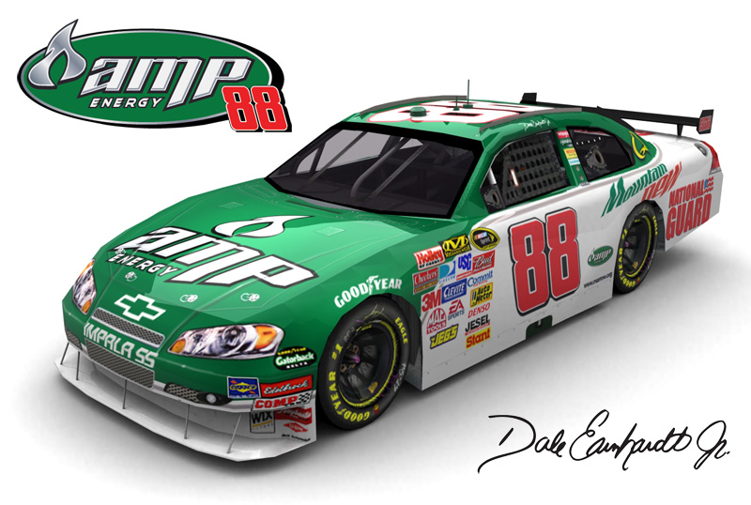
Which of these pictures represents acceleration?
Why??

Slide 11

Which vehicle is accelerating?
How can we tell?

Slide 12

Acceleration Equation
Where:
v_{f} = final velocity(in m/s)
v_{i} = initial velocity(in m/s)
t = time(in s)
a = acceleration(in m/s/s or m/s²)

Slide 13
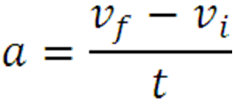



Ex.) A police car changes its velocity from 5 m/s to 20 m/s in 4 s. Find the rate of acceleration of the car.
Given:
v_{i} = 5 m/s
v_{f} = 20 m/s
t = 4 s
a = ?

Slide 14



Ex.) A ball rolling down a hill accelerates from 3 m/s to 8 m/s in 2.4 s. What is the rate of acceleration of the ball as it rolls down the hill?
Given:
v_{i} = 3 m/s
v_{f} = 8 m/s
t = 2.4 s
a = ?

Slide 15


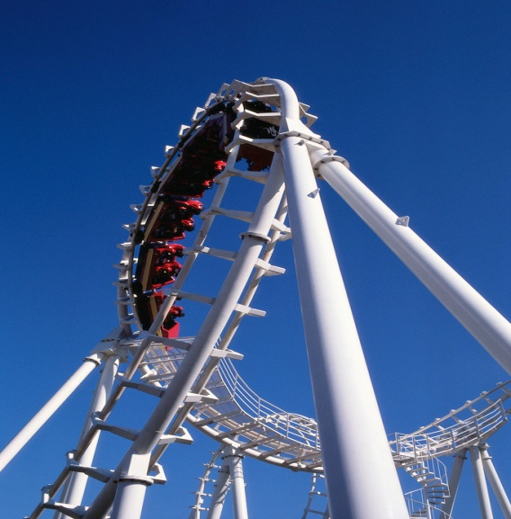
A roller coaster slows from 24 m/s to 8 m/s in 2.5 s. Find the rate of acceleration of the roller coaster.
Given:
v_{i} = 24 m/s
v_{f} = 8 m/s
t = 2.5 s
a = ?
Negative, therefore slowing down.

Slide 16


Ex.) A world class sprinter can accelerate from rest to a velocity of 10 m/s in 1.8 s. Determine the rate of acceleration of the sprinter?
Given:
v_{i} = 0 m/s
v_{f} = 10 m/s
t = 1.8 s
a = ?

Slide 17


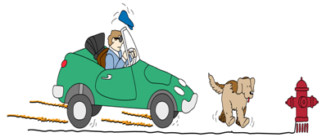
Ex.) While driving down the road at 14 m/s, a dog runs out in the road in front of you. You slam on brakes and come to a complete stop in 3.5 s. Find the rate of acceleration.
Given:
v_{i} =14 m/s
v_{f} = 0 m/s
t = 3.5 s
a = ?
Negative, therefore slowing down!!

Slide 18
A neighborhood dog sees a cat walking down the street and starts to chase it. The dog accelerates from 2 m/s to 5 m/s in 1.8 s. What is the acceleration of the dog?
1.1 m/s/s
1.67 m/s/s
2.78 m/s/s
3.89 m/s/s

Slide 19
Dale Jr. leaves his pit stall and accelerates from rest at a rate of 4.7 m/s². What velocity will Dale Jr. achieve in 5.2 s?
24.4 m/s
18.3 m/s
10.1 m/s
8.43 m/s

Slide 20
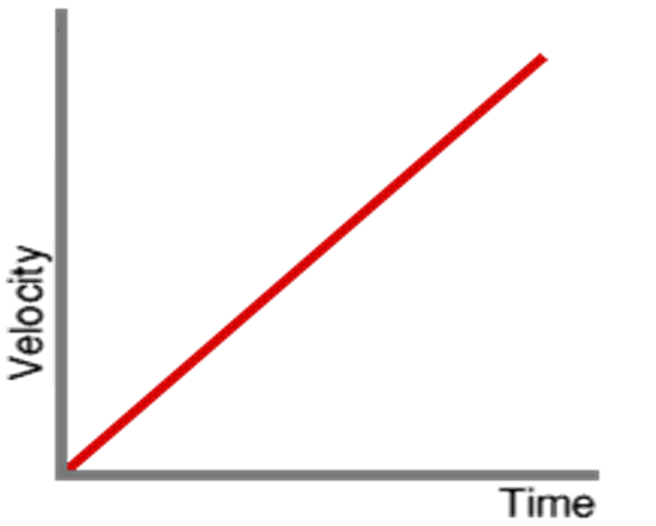
Velocity-Time Graphs
What does the slope of a velocity time graph represent?
Slope = rise
run
= velocity
time
= v_{f} –v_{i}
time
= acceleration

Slide 21






When does the slope of a velocity time graph = acceleration?
Always, you Clown!!!

Slide 22
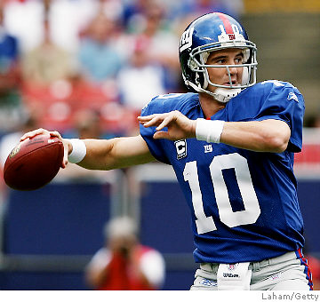
Take a break!! Don’t copy the next few slides. Just Pay attention!!!
P. S. I’ve got a ring now just like my big brother!!!

Slide 23
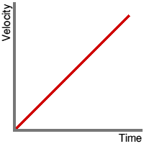
+ slope= + acceleration
Object is getting faster!!!

Slide 24
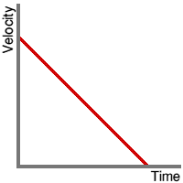
- slope= - acceleration
Object is getting slower!!!

Slide 25
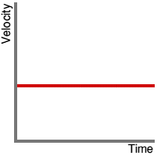
Is this object moving?
    Does it have a velocity?
What is the objects’ acceleration?

Slide 26
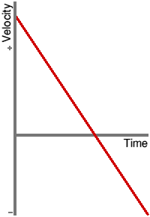
Because velocity is a vector quantity, direction is important.
+ velocities indicates one direction
- velocities indicates the opposite direction
+ velocities
- velocities

Slide 27
Slopes on a velocity time graph = the acceleration.
+ slopes = + acceleration
- slopes = - acceleration
When line is moving away from the x axis, acceleration is +(speeding up).
When line is moving toward the x axis, acceleration is –(slowing down).

Slide 28
Where is object getting faster?
Where is object getting slower?
Where does object stop and change direction?
Getting Slower
Stop, and change direction!!
Getting Faster

Slide 29
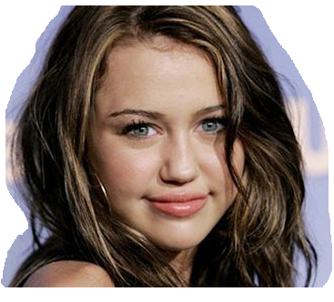
If I were you guys, I would copy the next Slide!!!
I bet the class didn’t know that Mr. Eidson is the President of my fan club!!!

Slide 30
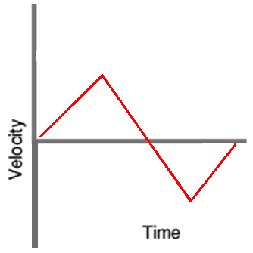
Starting on far left hand side of graph, explain what is happening with the motion of the object?
+ slope = speeding up
- slope = slowing down
Stops
Changes Direction
+ slope = speeding up
- slope = slowing down

Slide 31
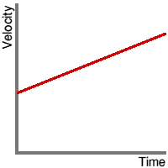
Explain the difference in these two graphs?

Slide 32
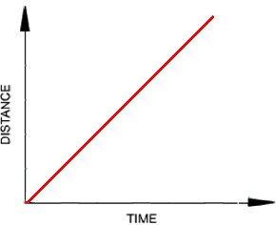
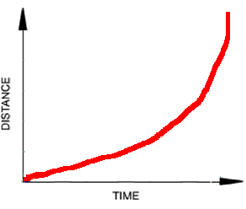
Which of the following graphs represent an object moving at a constant velocity?
A
B
C
D

Slide 33
Which of the following graphs represent an object slowing down?
A
B
C
D

Slide 34
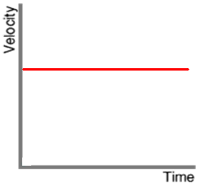
Which 2 graphs could represent the same motion?
1 and 2
2 and 3
1 and 4
3 and 4
1
2
3
4

